Slide 1

Becoming a journalist
Can I use my research notes to write the first draft of my newspaper article?
Look back over your research notes and everything we’ve discussed about newspaper headlines… Can you write an eye-catching headline for your story?

Slide 2
Write an article to inform young people about the truth behind the myths surrounding refugees and asylum seekers.
Produce texts which are appropriate to task, reader and purpose
Construct paragraphs and use cohesion within and between paragraphs

Slide 3
Getting across the important information…
Who?
What?
When?
Where?
Why?
How?
Look over your notes and note down this key information to help you plan your article.

Slide 4
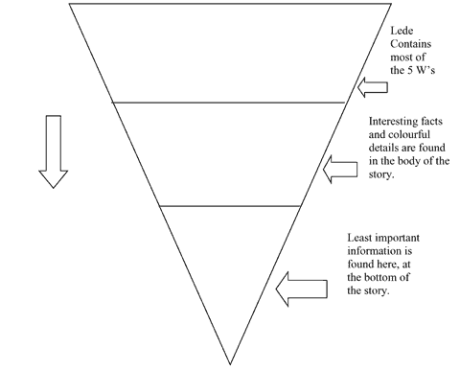
Structuring your article:
Notes:
Explain inverted pyramid structure: most important information given first, then details added as story progresses.

Slide 5
Remember the top tips!
It’s about people
Have an angle
Keep it objective
Quote people
Don’t get too descriptive – keep sentences and paragraphs short
Now get writing!

Slide 6
Now swap your first draft of your article with someone else in your group, read over it, and make suggestions for how it could be improved… You should focus on:
How far does the piece of writing seem like a newspaper article? Think about the top tips, as well as everything else we have discussed.
Is the article informing young people about the truth behind the myths surrounding refugees and asylum seekers?
How well does the writer use paragraphs to organise their ideas?
You should also consider spelling, grammar and punctuation, making suggestions to help your partner express their ideas more clearly.

