Slide 1
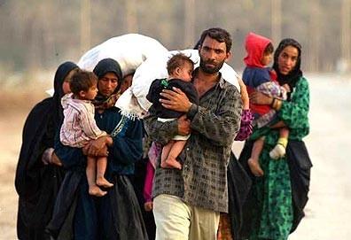
Forced to Flee
Can I understand some of the reasons people might be forced to leave their own country?
In your groups, read through the Universal Declaration of Human Rights. Why is it important that an agreement like this exists?

Slide 2
Read the case studies you have been given. These are real stories from real people.
Which human rights have been abused for these people?
How do their stories make you feel?
What could they have done to make things better for themselves?
Be ready to feed back your ideas.

Slide 3
Imagine you were in the same situation as one of the people you have read about. Write a poem about your experience, what you miss and your hopes for the future.
You will need to use your EMPATHY skills here. Also remember all the different ways you can use language in poetry to express your thoughts and feelings precisely to your reader.

Slide 4
What does this poem tell us about the experience of refugees?
What do we know about the speaker of the poem?
Refugee
So I have a new name – refugee.
Strange that a name should take away from me
My past, my personality and hope.
Strange refuge this.
So many seem to share this name – refugee
Yet we share so many differences.
I find no comfort in my new name.
I long to share my past, restore my pride,
To show, I too, in time, will offer more
Than I have borrowed.
For now the comfort that I seek
Resides in the old yet new name
I would choose – friend.
Rubimbo Bungwe (from Zimbabwe)
What questions could you ask to help you understand the poem better?

Slide 5
So, what is a refugee? In your book, write your own definition of this term.

