Slide 1
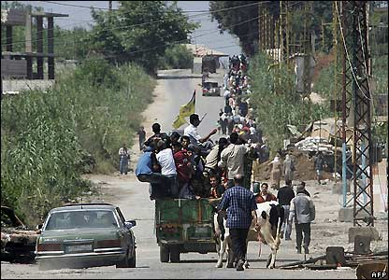
What is a Refugee?
Can I evaluate my knowledge of refugees and asylum seekers?
What do you already know/think/feel about refugees and asylum seekers? Note down your ideas.

Slide 2
Refugee

Slide 3
Asylum seeker

Slide 4
Refugee: Someone who has left their country because they are in danger of being harassed or attacked as a result of their race, religion, nationality, membership of a particular social group or political opinion and cannot trust their own country to protect them.
Asylum seeker: someone who has fled from their home country and is seeking refugee status in another country. The refugee definition is very strict and asylum seekers have to prove that they meet all aspects covered in the definition above if they are to be granted refugee status.

Slide 5
Complete the quiz you’ve been given individually to see how much you know about refugees and asylum seekers.

Slide 6
1: How many refugees are there worldwide?
a) 6.5 million
b) 54 million
c) 19.5 million
At the end of 2014, there were approximately 19.5 million refugees worldwide.

Slide 7
2: What percentage of the world’s refugees live in the UK?
a) 49%
b) 1%
c) 17%
Less than 1%

Slide 8
3: Which of the following countries has the highest number of refugees?
a) Turkey
b) UK
c) France
Turkey: 86% of the world’s refugees are hosted by poorer neighbouring countries, very few make it to Europe.

Slide 9
4: In 2014, which European country received the most asylum applications?
a) Sweden
b) UK
c) Germany
Germany, with 173,100 applications.

Slide 10
5: Approximately how many applications for asylum are made each year in the UK?
a) About 104,000
b) About 48,000
c) About 31,000
Approx 31,000: this figure has gone down from about 80,000 twenty years ago

Slide 11
6: How old are most asylum seekers?
a) under 21
b) 21-34
c) 34-50
Under 21: almost half of all the world’s refugees are children

Slide 12
Refugees have higher levels of education, skills and qulalifications than the Uk average
7: Most refugees are unskilled and lack qualifications.
True / False
A recent study showed that, over time, refugees contribute considerably more to society than they take
False

Slide 13
8: In the UK, how much support does an asylum seeker receive from the government?
More than a British citizen on benefits
The same as a British Citizen on benefits
Less than a British citizen on benefits
An asylum seeker receives 50% less than a British citizen – just £36.95 per week

Slide 14
How do you think asylum seekers are treated when they arrive in the UK?
Imagine you are an asylum seeker who has recently arrived in the UK. Write a diary entry about your experiences so far as an asylum seeker.

